Slide 1
CSE4095
Introduction to NLP
Iteration 2
GROUP 4
150116024 Ahmet Elburuz Gürbüz
150117018 Ahmet Önkol
150117023 Anıl Şenay
150117030 Beyza Aydoğan
150117072 Bilgehan Geçici
150116020 Muhammet Kürşat Açıkgöz

Slide 2
DEVELOPMENT PROCESS
There are three steps to build a classifier for classification:
Preprocessing
Removing stopwords
Tokenization
Stemming
Classifier
Evaluation

Slide 3
PREPROCESSING
Dataset words converted to lowercase format.
Punctuation marks from the dataset words are removed.
Tokenization process by using filtering options on the dataset words like extracting stopwords, applying some regex patterns.
Stemmization applied on the dataset words.

Slide 4
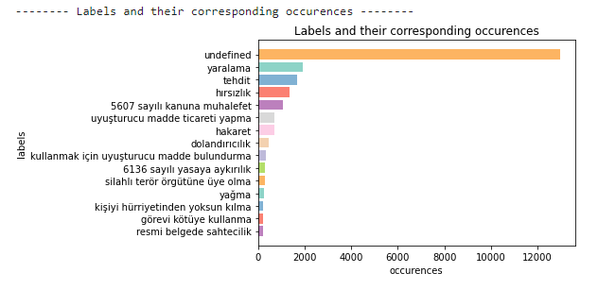
GENERAL STRUCTURE
Files from dataset are read
Labels created according to dataset
Data.json file is created which holds labels we decided

Slide 5
GENERATING TRAINING DATASETS
Write data into csv file
If there is no available train set created before, the csv file is created.
Read train set from CSV
If there is a previously created csv file that is available, the file is read. “Suç” and “İçtihat” are prepared as lists.
Split Dataset
Common approach is used for splitting the dataset which was 80% for training set and 20% for test set.
Vectorize
Using the data from our test set, a TF-IDF matrix is created.

Slide 6
CLASSIFIERS
Support Vector Machines (specifically, linear SVM)
Multinomial Naive Bayes
Logistic Regression

Slide 7
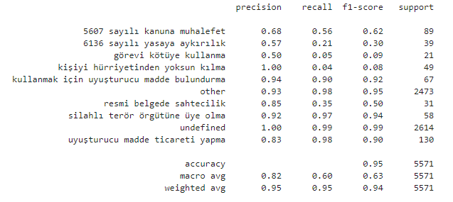
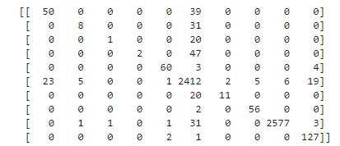
SUPPORT VECTOR MACHINE
Confusion Matrix
Classification Report

Slide 8

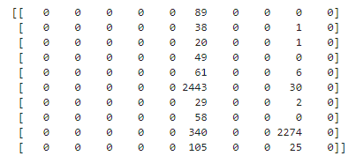
MULTINOMIAL NAIVE BAYES
Confusion Matrix
Classification Report

Slide 9
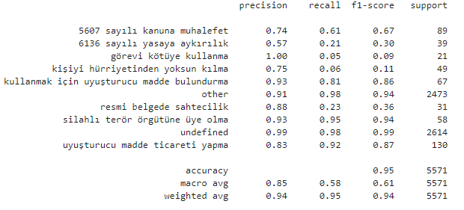
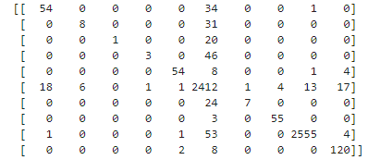
LOGISTIC REGRESSION
Confusion Matrix
Classification Report

Slide 10
Thanks!

